Slide 1
SIMPLICITY
The technical style demands formal yet simple language.
Use technical words only when you really need to.
Avoid unnecessary jargon.

Slide 2
SIMPLICITY
Saying things as simply as possible…
Can be achieved through;
.
Sentence structure
Vocabulary
Length
Use simple sentences
Avoid:
Keep sentences limited to 8-/-12 words
fancy/arcane vocabulary,
Pompous words
Jargon,

Slide 3
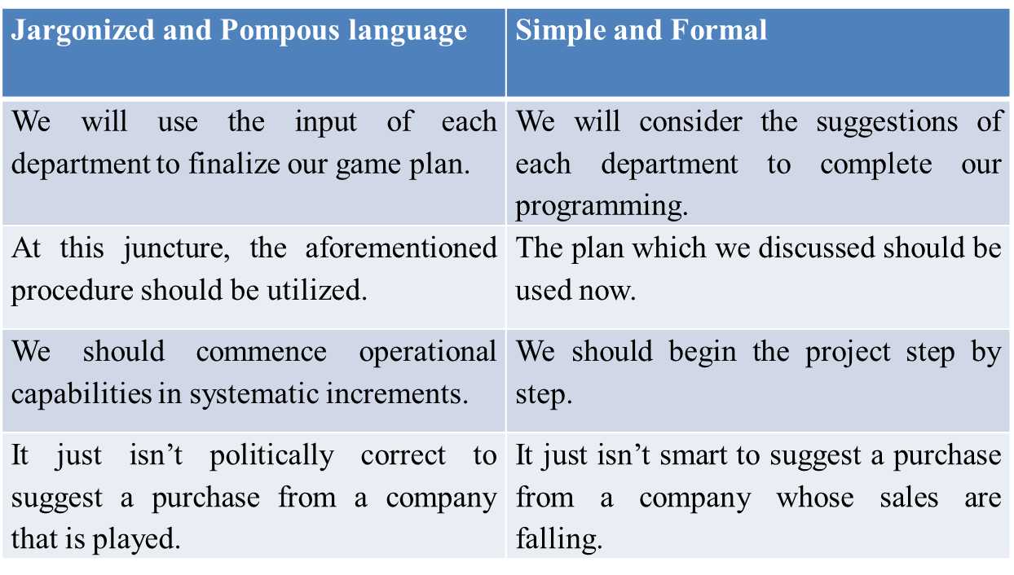
Sample

Slide 4
Re-write the following sentences by making
them simple and reader friendly.
Last but not least, the article sends an important message.
My main ambition in life is not to make a fortune, since I know that, as they say, "Money is the root of all evil."
For Baldwin, the problem never reared its ugly head until one dreadful night in New Jersey.
The building's owners offered the inspectors many financial incentives to overlook code violations

Slide 5
OBJECTIVITY
‘Subjective’ refers to information that is based on personal opinions
‘Objective’ refers to information that is based on factual evidence

Slide 6
OBJECTIVITY- Personal Language
1.Avoid personal language unless necessary. Compare the examples below:
1. I got informed consent in accordance with the procedures specified for research
Informed consent was obtained in accordance with the procedures specified for
research
2. I believe that there is a discrepancy between theory and practice…
Research suggests that there is a discrepancy between theory and practice
3. I interviewed a total of 22 parents during the month of December 2023…
A total of 22 parents were interviewed during the month of December 2023…
4. I gave completed questionnaires a number for identification purposes…
Completed questionnaires were allocated a number for identification purposes…

Slide 7
OBJECTIVITY-Judgmental Language
2. Avoid Judgmental Language.
Avoid making a personal judgment.
Drawing conclusions based on your previously held beliefs, rather than through a review of the relevant facts.
How do personal beliefs pose a problem in scientific or professional communication?
Beliefs you may have held at one time could later be
disproved.

Slide 8
OBJECTIVITY-Avoid Judgmental Language
International schools are always elitist…
International schools are often viewed as elitist…
2. Jessen’s (1956) theory is the most influential for scholars in education
Jessen’s (1956) theory remains one of the most influential for scholars in education…
3. Smith’s (2009) paper made such a remarkable contribution to the field…
Smith’s (2009) paper made a major contribution to the field…
4. Gorard’s (1999, pp.31-33) study provided an awesome classification
Model.
Gorard’s (1999, pp.31-33) study provided a concise classification
Model.

Slide 9
OBJECTIVITY-Emotive Language
Emotive language appeals to the emotions or values of your reader.
Emotive language tends to use superlatives and/or exaggeration in an attempt to incite an emotional reaction

Slide 10
OBJECTIVITY-emotive language
Japanese orthography is too difficult to be well-understood…
Japanese orthography is not generally well-understood…
These really lucky people may be advantaged by healthcare
services that…
These people may be advantaged by healthcare services that…
3. Sydney represents an incredibly vivacious school market…
Sydney represents an active and dynamic school market…

Slide 11
Make objective
I don’t think that this company cares about
what their customers think of them.
In my experience, they haven’t been the best.
This operating system isn’t the best one out
there, it’s too slow for most people’s needs.

Slide 12
Re-write the following and make it objective
Our lives at home converged around the pleasantly-shaped kitchen table. It was
the magnet that drew our family together quite warmly. Cut from the sturdiest
oak, the table was tough, smooth, and long enough for my mother, my two
sisters, and me to work or play on at the same time. Our favorite light blue
ceramic tile, stationed in the right corner, was the table's sole defense against
the ravages of everything from a steaming teapot to the latest red-hot gadget
from the Sears catalogue. More often than not, however, the heat would spread
quickly beyond the small tile and onto the checkered oilcloth, which just as
quickly exuded a rank and sour odor. Yet no matter how intensely the four of us
competed for elbow room at the table, none dared venture near the lone dinner
place arranged securely to the left of the tile. There was no telling when he
would get home from work, but, when he did, he expected the food to be ready-
-steaming hot. He liked to eat right away--steak mostly--two bloody but thick
pieces.

Slide 13
Objective version
The kitchen table is rectangular, seventy-two inches long and thirty
inches wide. Made of a two-inch-thick piece of oak, its top is covered
with a waxy oil-cloth patterned in dark red and blue squares against a
white background. In the right corner, close to the wall, a square blue
ceramic tile serves as the protective base for a brown earthenware
teapot. A single white placemat has been set to the left of the tile, with a
knife and fork on either side of a white dinner plate, around nine inches
in diameter. On the plate are two thick pieces of steak.

Slide 14
ECONOMY- Cut the Clutter
The most significant and difficult trait!
“The secret of good writing is to strip every
sentence to its cleanest components. Every
word that: serves no function, every long
word that could be a short word, every
adverb that carries the same meaning that’s
already in the verb, every passive
construction that leaves the reader unsure of
who is doing what—these are the thousand
and one adulterants that weaken the strength
of a sentence. And they usually occur in
proportion to the education and rank.”
-- William Zinsser in On Writing Well, 1976

Slide 15
Economize the following phrases
■ A majority of
■ A number of
■ Are of the same opinion
■ Less frequently occurring
■ All three of the
■ At that point in time
■ Due to the fact that
Most
Many
Agreed
Rare
Then
All
Because

Slide 16
Cut The Clutter
Trick Set 1
Eliminate negatives
Eliminate superfluous uses of “there are/there is”

Slide 17
ECONOMY-ELIMINATE NEGATIVES
She was not often right.
She was usually wrong.
2. She did not want to perform the experiment incorrectly.
She wanted to perform the experiment correctly.
3. They did not believe the drug was harmful.
They believed the drug was safe.
■ Not harmful safe
■ Not important unimportant
■ Does not have lacks
■ Did not remember forgot
■ Did not succeed failed
■ Didn’t pay attention to ignored

Slide 18
ECONOMY- Eliminate “THERE ARE/THERE IS”
1. There are many ways in which we can arrange the pulleys.
We can arrange the pulleys in many ways.
2. There was a long line of bacteria on the plate.
Bacteria lined the plate.
3. There are many physicists who like to write.
Many physicists like to write.
4. The data confirm that there is an association between vegetables and cancer.
The data confirm an association between vegetables and
cancer.

Slide 19
Cut The Clutter
Trick Set 2
Avoid turning verbs into nouns
Don’t bury the main verb
Write with strong verbs

Slide 20
ECONOMY
1. Use strong verbs
Compare:
“Loud music came from speakers embedded in the walls, and the
entire arena moved as the hungry crowd got to its feet.”
With:
“Loud music exploded from speakers embedded in the walls, and
the entire arena shook as the hungry crowd leaped to its feet.”

Slide 21
ECONOMY
And it is the matter of “Picking the right verb!” Read the following
paragraph
The WHO reports that approximately two-thirds of the world’s
diabetics are found in developing countries, and estimates that
the number of diabetics in these countries will double in the next 25
year.
The WHO estimates that two-thirds of the world’s diabetics are
found in developing countries, and projects that the number of
diabetics in these countries will double in the next 25 years.

Slide 22
ECONOMY
2. Do not turn verbs into nouns
When we turn a verb or adjective into a noun, we create a
NOMINALIZATION.

Slide 23
A need exists for more efficient candidate selection.
We must select candidates more efficiently.
There is the possibility of prior approval.
He may approve of it ahead of time.
The establishment of a different approach on the part of the committee has become a necessity.
The committee must approach it differently.
Our request is that on your return, you conduct a review of the data and provide an immediate report.
We request that when you return, you review the data and report immediately.

Slide 24
Examples of Nominalizations
Nominalizations | Liberated Verbs
A need exists for more efficient candidate selection. | We must select candidates more efficiently.
There is the possibility of prior approval. | He may approve of it ahead of time.
The establishment of a different approach on the part of the committee has become a necessity. | The committee must approach it differently.
Our request is that on your return, you conduct a review of the data and provide an immediate report. | We request that when you return, you review the data and report immediately.

Slide 25
COMMON NOMINALIZATIONS verbs
Liberated verb | Nominalization
Discover | Discovery
Move | Movement
Resist | Resistance
React | Reaction
Fail | Failure
Refuse | Refusal
Analysis | Analyze
Destabilization | Destabilize
Study | Studies

Slide 26
COMMON NOMINALIZATIONS adjectives
Adjectives | Nominalization
Careless | Carelessness
Difficult | Difficulty
Different | Difference
Applicable | Applicability
Intense | intensity
Applicable | Application

Slide 27
LIBERATE DISGUISED VERBS
make a recommendation Recommend
formulate an argument Argue
raise an objection Object
make restitution Restore
express resentment Resent
arrive at a conclusion Conclude
perform an analysis Analyze
develop a plan
exercise conformity
undertake a development
find a solution
make a decision

Slide 28
LIBERATE DISGUISED VERBS
The theory makes the postulation that long-term stability of species (with only minor modifications) in paleontologic time is punctuated by bursts of time in which many species are extinguished.
Freshmen have frequently made complaints about the cafeteria food.
Species managed to achieve evolution from parental species that made an escape from extinction by virtue of their geographic isolation.
The Sumerians are credited with the invention of writing toward the end of the fourth millennium B.C.
Neither the clay tablet nor the papyrus roll underwent much change in form during the next three thousand years.

Slide 29
Economy
3. Do not burry the main verb
Keep the subject and main verb (predicate) close
together at the start of the sentence.

Slide 30
Don’t bury the main verb
The case of the buried predicate…
One study of 930 adults with multiple sclerosis (MS) receiving care in one of two managed care settings or in a fee-for-service setting, found that only two-thirds of those needing to contact a
neurologist for an Ms-related problem in the prior 6 months had done so (Vickrey et al 1999).

Slide 31
Avoiding Redundancy
Why say,
“The used car will cost the sum of $1,000.00”?
It is more concise to say,
_______________________________________.

Slide 32
Avoiding Redundancy
Wordy Sentence | Less Wordy Sentence
We collaborated together on the projects. | We collaborated on the project.
This is a brand new innovation. | This is an innovation.
The other alternative is to eat soup. | The alternative is to eat soup.

Slide 33
Avoiding Prepositional Phrases
Prepositional phrases create wordy sentences. Consider the following examples.
Wordy Sentence | Concise Sentence
I will see you in the near future | I will see you soon.
I am in receipt of your e-mail message requesting an increase in pay. | I received your e-mail message requesting a pay raise.
He drove at a rapid rate. | He drove rapidly.

